Slide 1
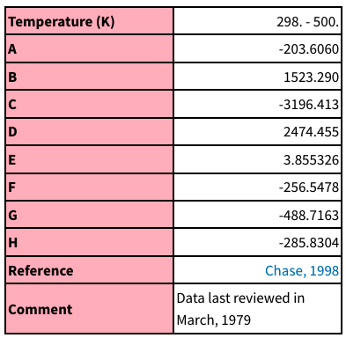

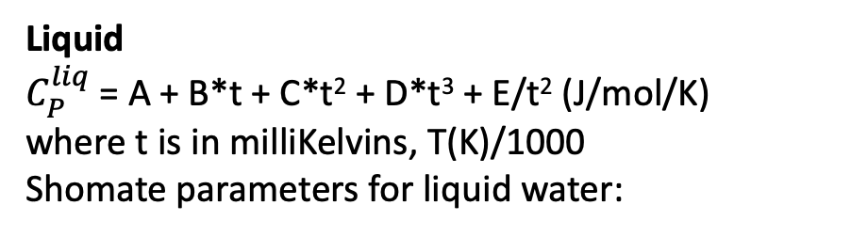
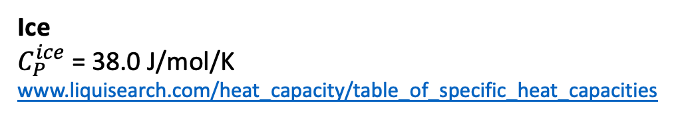
At 298 K, C_{P} values for water are (J/mol/K):
Gas: 33.6
Liquid: 75.4
Ice: C_{p} = 38.0 (this is actually at -10 C)
Liquid
$C_{P}^{liq}$ = A + B*t + C*t² + D*t³ + E/t² (J/mol/K)
where t is in milliKelvins, T(K)/1000
Shomate parameters for liquid water:
Vapor
$C_{P}^{vapor}$= C_{P}º + m*(T-300) (J/mol/K)
Parameters for water vapor:
C_{p}º = 33.58 J/mol/K
m = 0.0067 J/mol/K²
www.engineeringtoolbox.com/water-vapor-d_979.html
Ice
$C_{P}^{ice}$ = 38.0 J/mol/K
www.liquisearch.com/heat_capacity/table_of_specific_heat_capacities
https://webbook.nist.gov/chemistry/name-ser/

Slide 2
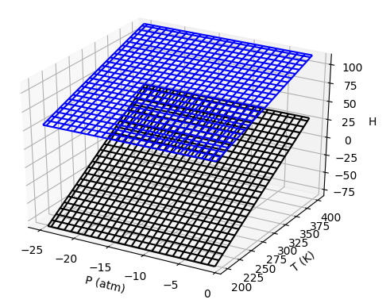
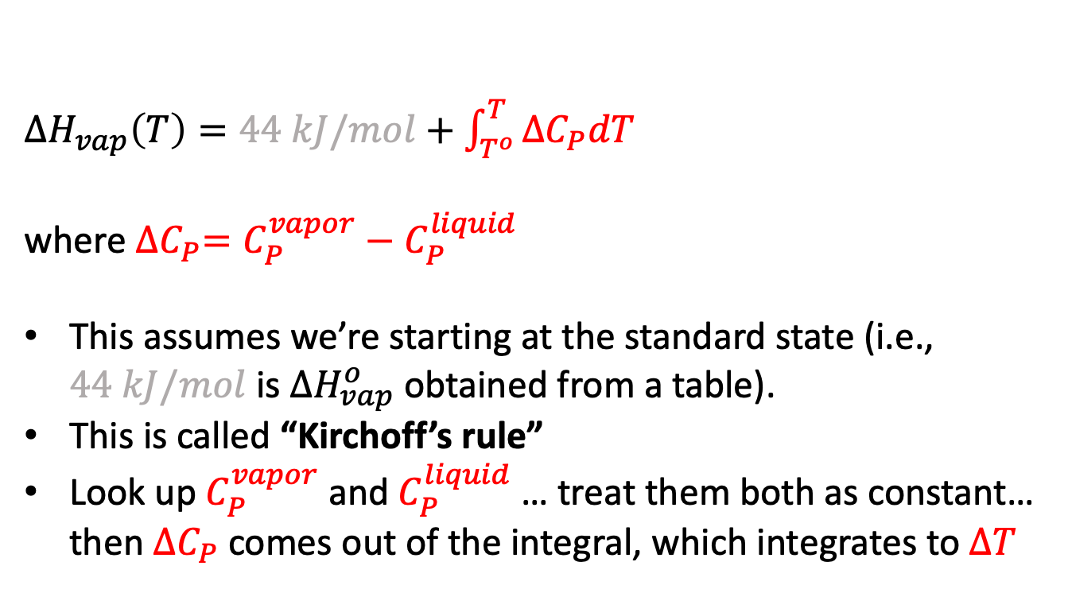
$∆H_{rxn}$: Kirchoff’s rule
$∆H_{vap}\left(T\right)=44 kJ/mol+\int_{T^{o}}^{T}{{∆C}_{P}dT}$
where ${∆C}_{P}=C_{P}^{vapor}−C_{P}^{liquid}$
This assumes we’re starting at the standard state (i.e., $44 kJ/mol$ is $∆H_{vap}^{o}$ obtained from a table).
This is called “Kirchoff’s rule”
Look up $C_{P}^{vapor}$ and $C_{P}^{liquid}$ … treat them both as constant… then ${∆C}_{P}$ comes out of the integral, which integrates to $∆T$

